Slide 1

Financial Analytics in Python
Notes:
Hello guys,
welcome to this new video, in this video we are going to be talking about financial analytics in Python
Analytics is a really big topic and it is very difficult to cover the entire topic in just one video
What I will try to do in this video is too kind of introduce you all to the field of financial analytics and also how financial analytics works in stock trading so particularly in this video I am going to be taking up an example of stock trading with which I hopefully I will be able to clear your concepts regarding financial analytics and I hopefully will inspire you too kind of pursue more of financial analytics.

Slide 2
AGENDA OF THE VIDEO
Introduction to the Field of Financial Analytics
Types of Financial Data that we can analyse
What is Stock of a Business?
Stock Trading.
What are the different variables of interest in stock Trading?
Stock Market Data for different Organizations.
Should i invest in this Stock? How to answer this question using Financial Analytics?
Obtaining Returns from stock prices.
Reward metrics. How can i assess the return of my stock?
Risk metrics. How can i assess the risk of my stock?
Risk adjusted metrics. Giving one number of assess my investment decision.
Task for you… (Analyse the stock of your favorite company)
Notes:
In this slide, what I want to discuss is I want to discuss what will be the agenda of this video. So, particularly, I am going to be starting with a very small discussion on the field of financial analytics, and then I'm going to be talking about what are the different types of financial data that are available out there for us to analyze. And then I'm going to be talking about the stock of a business and how does, stock trading works. And finally, we are going to be talking about the different variables of interest in stock trading so what are the different variables that we might be interested in. If we are interested in algorithmic, stock trading. Okay, once we do that. After that, we are only going to be talking about, stock trading with Python. So I'm going to be taking a stock market data set, and that data set, we'll be having some 500 organizations stock data, and we are going to be taking up that data extracting one organization and trying to answer this question that should I invest in that particular organization or not. So this is what will be the agent of this whole video. And as we move along. Along the video we are going to be discussing various things like how can I obtain returns from stock prices and further. How can I measure the reward behavior of my stock and further what is the risk associated with my stock, and finally I'm going to be combining the risk factor, and the reward factor of my stock to come up with this measure called risk adjusted metric. So this is the whole idea and agenda of this video. And further, at the end of the video I will task for you so that you can know what are the various things that that you have learned. Okay.

Slide 3
Introduction to the Field of Analytics
What is Analytics?
Analytics is a field of study where the main focus is to derive insights from the data.
Now, where there is data, analytics can be leveraged to the organizations advantage.
Financial analytics in particular deals with analytical method on Financial dataset (Business Profit/loss, Expenses, Stock Market, Share Market, Crypto Market, Banking Data) to derive business value for the concerned organization.
Notes:
So with this particular slide, I want to introduce you all to the field of analytics. So first question is, what is analytics, or rather I will be introducing you to the field of financial analytics. So, before I actually come to the discussion on financial analytics. I would like you to reflect back and talk about, and think about and kind of see, or rather,
see if you can come up with a definition of analytics.
So analytics is essentially anything related to data. So, I have a problem. I have a data set. Can I map these two different things, can I map, my data to my problem, to kind of extract some insights into the problem that I'm trying to solve. This is what we mean by analytics. And what do we mean by financial analytics. So, this is what we do in financial analytics to, but the data set, the type of the data set that we're having in financial analytics is obviously financial, is related to finance. Okay, so this is the basic idea to the field of financial analytics and I hope you get this particular idea.

Slide 4
Finacial Data
Predictive Sales Analytics Data
Client Profitability analysis
Cash Flow
Value Driver Analytics
Stock Market Analytics
Financial Markets Trading Analytics
Notes:
In this slide, I want to talk about what are the different types of financial data. We have one data type, I have already talked about, or one field I have already discussed about is known as stock data with historical data, we will be having the stock prices of an organization for different time periods and apart from a stock data, financial data and financial analytics is not just limited to stock data financial analytics is really broad topic. So, these are the different topics, these are the different types of data that we might encounter in our day to day life in financial analytics. So, the first type of data that we might encounter in financial analytics is known as predictive sales analytics data. And then we will be having client profitability analysis data, we are having cash flow data expenses out income in is essentially the concept behind cash flow, we can have stock market analytics financial market trading analytics. So I hope you get this particular points.

Slide 5
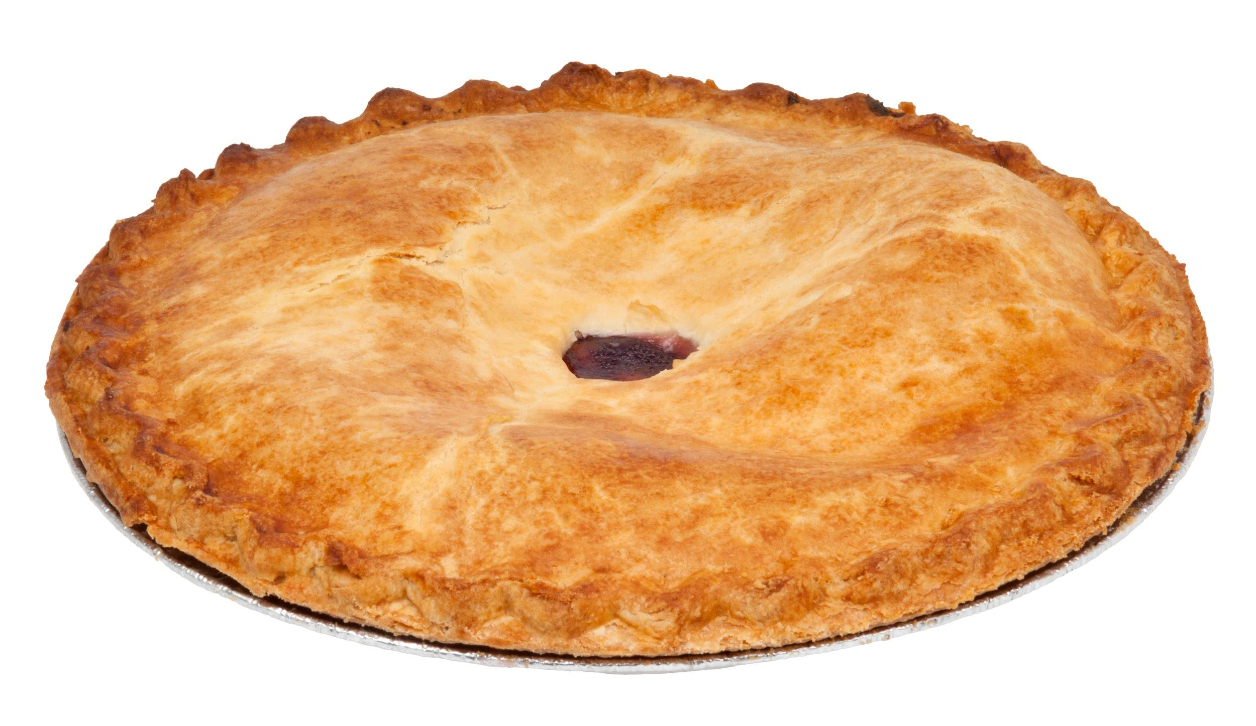
Business Stock
The whole business can be thought of as a pie and each shareholder has some share in that pie. Essentially, what shareholders hold is stock.
There is a value of the whole company and if we divide that by the number stocks, we get the price of each stock or share.
The value of company is not fixed throughout but rather keeps changing according to the market fluctuations.
Notes:
In this particular video, I want to start talking about business stocks.
So on your right side you can clearly see this example which I have intentionally kept here and you can think of this whole pie as a business and if I am having some share of that pie then I can call that share as my stock and this is the idea behind business stocks.
shares of every business is kind of divided in some shares so every business you can think of as by which is divided in 3 years at each organisation each individual can have their own share of that pie’s share of that organisation.
so essentially a stakeholder or rather I should say a shareholder is someone who holds the share who has some share of a business so this is the first thing that I wanted to discuss with you.
The second thing Is that a company which is registered with the market financial market will be a trading a let their stock be traded in the financial market so if that happens that companies share will not have same size throughout the day so in each day the companies price might fluctuate unlock it can decrease or increase many times in a day and for the the share the same shareholders might not be with the company on the next day because the companies shares are fluctuating that is why some people buy and sell the companies talk to other share old and some might be treated

Slide 6
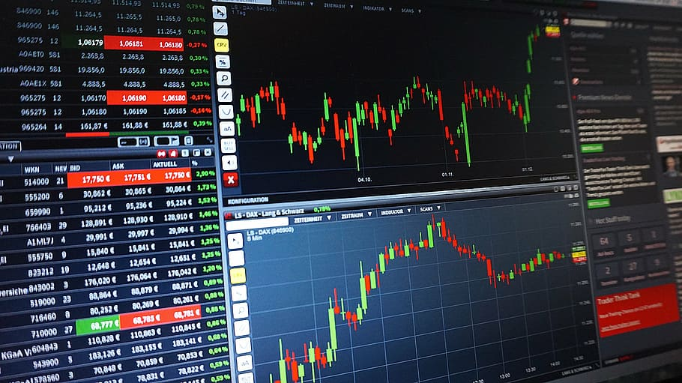
Stock Trading
Now, suppose at a given day, a company has some 500 shareholders.
The next day it is necessary that the same shareholders will hold the shares in the company. It might happen that next day some other 500 shareholders are there for the same company.
This happens because every registered company who has stock participate in what is called as stock trading. Their stocks are traded. So, if a company’s stock is increasing a lot, then it might happen someone decides to sell those to earn some return.
Notes:
So on this slide, I want to start talking about, stock trading. So earlier, we discussed, what do we mean by stock. And in this slide, we will actually understand what do we mean by stock trading. So essentially, if I have to just tell you the literal meaning of this word, then I would say the meaning of stock trading is to actually sell and purchase the stocks. So, people do this to earn money to earn money on their investments. Suppose, I am interested in purchasing a stock for a company. Then I will have to check the stock prices of that particular company, on a particular date, because in the stock market, the prices of the stocks, keeps fluctuating on a day to day basis. So, it never stays the same. According to market fluctuations and according to the company's situation, current situation. It keeps on fluctuating.
So, essentially what I'm trying to convey to you in this particular way, in this particular slide is that, stock trading is a method of trading stocks, and it is one of the most challenging tasks for an investor, because there are thousands of stock companies out there, and which one to invest all money in is a very crucial question that every investor is faced with. So, this is why I have discussed this particular small topic this particular topic, and by turn or in particular, financial analytics offers as a way to solve this particular issue that investor face and kind of recommend them, of which stock, they should invest in using quantitative analysis, and machine learning.

Slide 7
Variables of Interest in Stock Trading
Every day, Trading happens and at the end of each day, for each company’s stocks, the following key parameters are important to kind of see how is company doing in the financial market:
Open Price Value
Closing Price Value
Lowest Price Value
Highest Price Value
Volume of sales
Notes:
In the last slide, we talked about stock trading. And in this slide, I want to talk about what are the different variables that happens that changes on a day to day basis when stock trading happens. Okay.
So essentially we are only looking at stock prices, and those stock prices can come in various forms, like when trade begins on a particular day, one price that we might be interested in is open price value. And once the trade ends for a particular day, we might be interested in closing price value. And throughout from the beginning of the trade trading, and all the way to the end of the trading. Various transactions happens and the value of the stock fluctuates, it goes up and down. So we might be interested in highest price value or which means, what was the highest value highest value. It took in that particular day, or in that particular time interval. Okay. And we also might be interested in volume of the sales for that particular day so for each day. These are the five variables that we might be interested in in the stock trading.

Slide 8
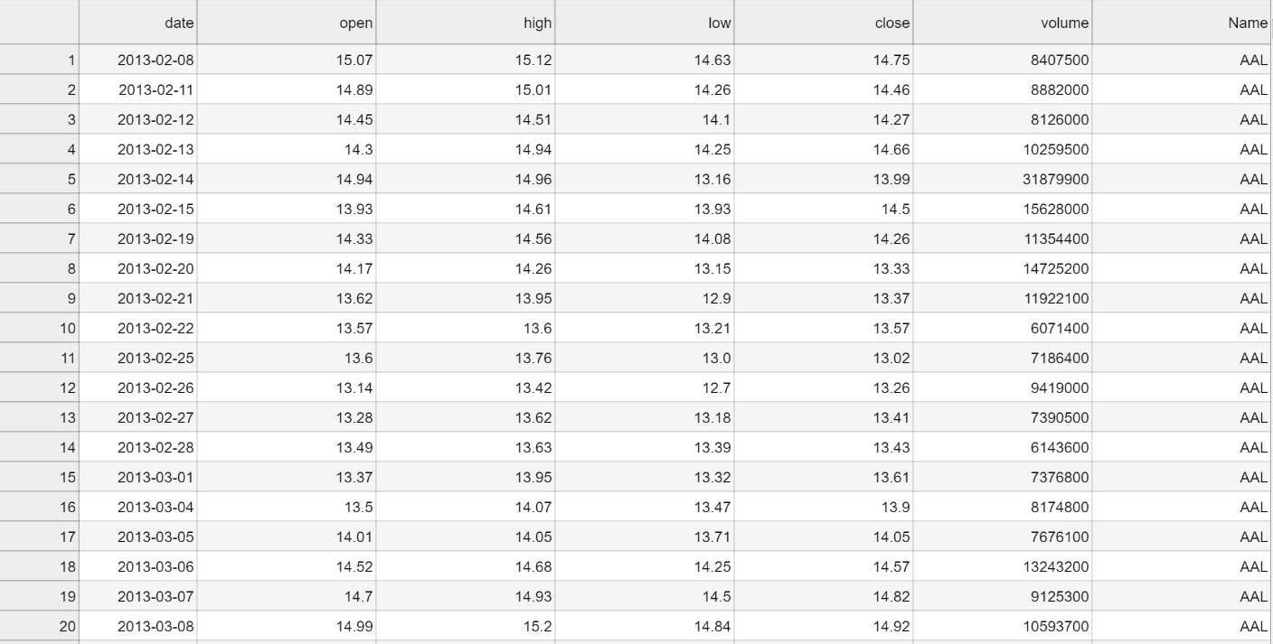
Stock Market Data For different Organizations
Notes:
In this particular slide, I have shown you a data set that we are going to be working with in this particular video.
And this data set is having two extra columns, than what we discussed earlier earlier we discussed that, there are five important variables attributes of stock trading that we are, we might be interested in.
But here, I've also added Date column and Name column. Date column is essentially what is reflecting on what day the transaction took place and also we have added this volume, volume is essentially how much sell of that particular stock happened. How much transaction on that particular stock happened. And also I have added the name of the organization that is corresponding to that particular stock.

Slide 9
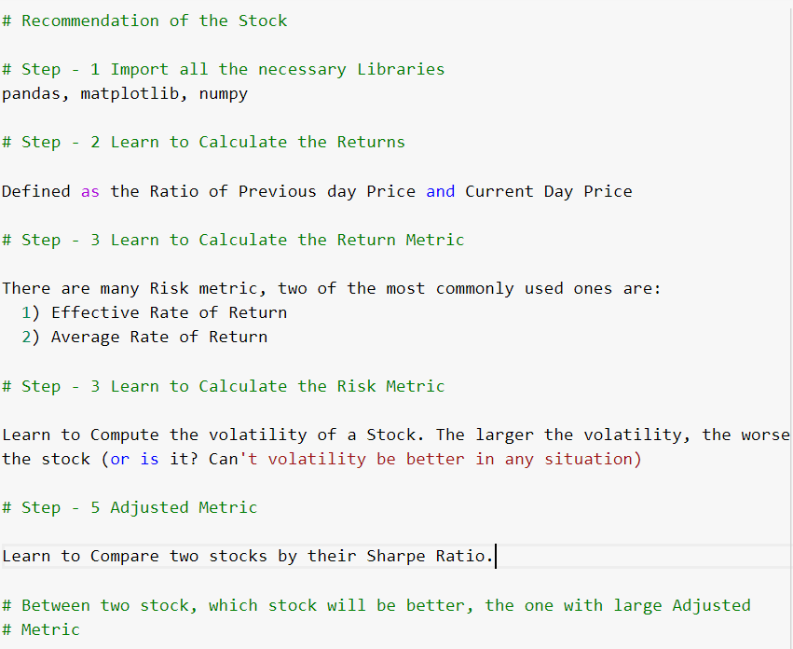
Which stock should I invest in? How to answer this question?
Notes:
On this slide, what I have done is I have laid out all the steps that we are going to be following. To answer this question, which is posed on us. And the question is which stocks should I invest in. So, how to answer this question, how can I answer this question using financial analytics. So, there are some sequence of steps that we are going to be following. To answer this question, and those steps involve five steps five sub steps, the step one will be to import all the libraries in Python, and the step two will be to calculate the returns, using the closing prices of that stock and step three will be to calculate the return metric or reward metric. We can also call it, and the step four will be to calculate the risk matrix. And step five will be to calculate the adjusted metric, and using an adjusted metric we will be able to tell, and we will be able to answer this question in a better way.

Slide 10
Steps that we will follow for Finding the best stock?
Step - 1 Obtaining Returns from stock prices.
Step - 2 Reward metrics. How can i assess the return of my stock?
Step - 3 Risk metrics. How can i assess the risk of my stock?
Step - 4 Risk adjusted metrics. Giving one number of assess my investment decision.
Notes:
To answer this question, which is posed on us. And the question is which stocks should I invest in. So, how to answer this question, how can I answer this question using financial analytics. So, there are some sequence of steps that we are going to be following. To answer this question, and those steps involve five steps five sub steps, the step one will be to import all the libraries in Python, and the step two will be to calculate the returns, using the closing prices of that stock and step three will be to calculate the return metric or reward metric. We can also call it, and the step four will be to calculate the risk matrix. And step five will be to calculate the adjusted metric, and using an adjusted metric we will be able to tell, and we will be able to answer this question in a better way.

Slide 11
Obtaining Returns for each Day/Month/Year
Notes:
In this slide, I want to start talking about how can I obtain returns for each day, month or year, it simply doesn't matter what you are considering you can consider day, month, and year, but your data has to be according to that. Now if I talk about calculating the return for today. How I might be able to do that. Now let us suppose for the time being that. Today, the stock price or the closing price of a stock that I'm interested in investing is 120, and the price of that particular stock Yesterday was 100. What do you think how I might go about calculating the return for today. Essentially, if I invested this money yesterday with 100, rupees and If I sell that that particular stock today, then I am getting 20 extra rupees. Now to calculate the return, what I can do is I can simply divide this 20 by the closing price of yesterday. So this is what I have done here. Notice here that on this particular formula. I have just returned in a mathematical form, what I have just spoke.

Slide 12

Return Metrics
Effective Rate of Return
Average Rate of Return
Notes:
Not just talk about a return metric. How can I come up with one single number to report to the potential investor to kind of tell him this is how this particular stock performs. Now, what was the problem with a list of returns that we computed earlier, that list of returns doesn't actually tell us anything. The reason is that that list of returns can be a huge list. And we're going over that list will be a very arduous task. And we might be interested in coming up with a number, a number which will tell us exactly how those lists of numbers represent these stocks. So there are two return metrics that we can compute, the first return metric is effective rate of return. And the second return metric is average rate of return, average rate of return is quite easy to understand, because what we are essentially trying to do in that is we are just taking the average of all the returns that we computed in the previous slide, and using the effective rate of return, what we are doing is we are taking the we are First of all, adding one to all the returns, and we are calculating the geometric mean of those resulting values. And once we compute that we are subtracting one from it. So I hope it makes sense.

Slide 13

Risk Metric
Volatility of Returns
Volatility of returns is simply the standard deviation of the collections of return values.
Notes:
Okay.
So, in this particular slide. What I want to talk about is I want to talk about a risk metric.
So every stock is having some sort of reward associated with it, but at the same time, there can be some risk associated with it. And how can I measure risk associated with a stock price. Essentially, the risk will be measured using the concept of volatility, How much variation is there in the stock that will decide the risk of that particular stock. So if it has, if it is having high variation, then obviously the, then obviously the volatility of the returns are quite huge. So what we can do to compute a risk metric is simply compute the standard deviation of the collection of returns that we computed earlier. So that collection of returns. I can compute the standard deviation of that collection of returns to come up with this standard deviation.

Slide 14
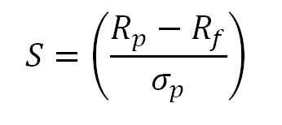
Risk adjusted Metrics
SHARPE RATIO
The Rp is the effective rate of return while Rf is the benchmark rate of return and the denominator is volatility
Notes:
Okay, so this slide is a very important slide.
And the reason is that, in this slide, what we are doing going to do is we are going to combine the metric that we have so far studied, we studied two metrics .
The first one is reward metric or return metric. And the second one is risk metric, and both of those metric were a single number, and those number were kind of showing us what are the reward associated with a particular stock, and the, the risk associated associated with a particular stock.
Now what we want to do is we want to kind of combine these two concepts and using these two concept we want to come up with one more number. And that new number will tell us exactly, exactly a metric, with which we will be able to recommend a particular investor, whether he or she should invest in that particular stock or not, by giving him or her information about our a ratio which is known as Sharpe ratio, and that ratio takes into account both the reward metric and risk metric that we have studied earlier, you can clearly see here, what we have just done is we have divided it by volatility and volatility is calculated using a standard deviation. And we have taken this RP as an effective rate of return. And this RF is a benchmark rate of return, and that benchmark rate of return is essentially can be decided by anyone.
But remember, if you are comparing two stocks, then for both the stocks, the benchmark rate of return needs to be same. Otherwise, the Sharpe ratio might give you misleading results. Okay, So I hope you got this particular point.

Slide 15
Task For you..
Your task in this Financial Analytics Video is to Take all that you have learned in this video and try to work on other different types of stocks that the dataset has and try to come up with the answer to the following questions:
Which stock is having the best sharpe ratio?
Which stock has greatest volatility?
Which stock should you invest in from the data?
Notes:
Finally, on this slide. What I have done is I have shared a task with you and your task in this slide will be to apply whatever you have learned in this particular video. And there are three questions that I would like you to answer. And those three equations, you have to apply whatever methods, you have learned in this video to the data set that I worked with, and you have to come up with these three questions. Okay, so the questions are. The first question is, what stock is having the highest Sharpe ratio or the best Sharpe ratio. And after answering that question you need to answer, which stock has greatest volatility. Okay. And the third question will be, which stocks should you invest in from the data. so data set is having approximately 505 different symbols or organizations, and those different organizations, which have, which, among those organizations, should you invest in. So that is what your task is.

